Slide 1
Taiwan Highway No. 3 Slope Failure
Jaren Knighton
Thomas Scherbel
Luke Rowley
Notes:
At first let’s try to get to the video cause it’s longer and
shows the failure plane and wall debris really well.

Slide 2
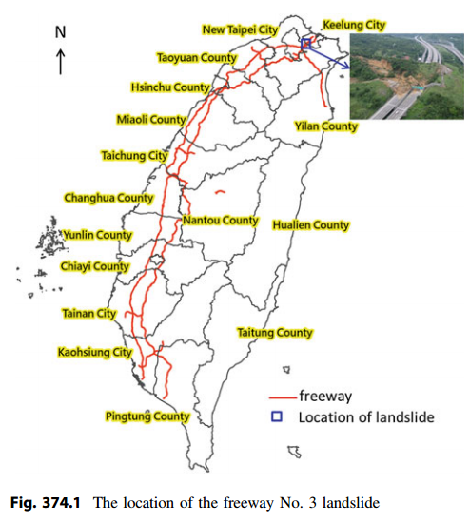
Notes:
Location of Slide

Slide 3
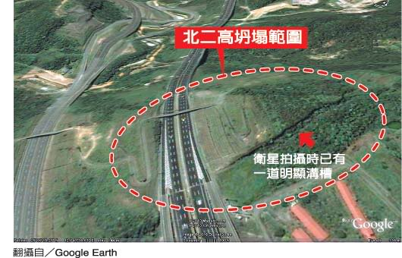
Notes:
Before Image
Notice failure plane
White text says “A defined trench was already present when this satellite image was taken.”
Red text says “Area of landslide”

Slide 4
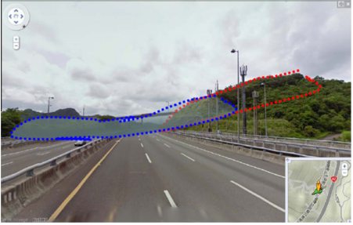
Notes:
Another before picture, outlining area that fell
Blue=where it fell, red is where it was before

Slide 5
Helicopter view of landslide
https://www.youtube.com/watch?v=-WMPPUnQU5Y
Notes:
We may want to get to this one quickly so that we can show the video, pointing out some of the specifics of the site.
-I think that the video should go before the pictures, to kind of give the sense of what happened, then the pictures can be more clear… I think, but we don’t need to do that.
Watching starting at 1:00 on double speed is pretty good.

Slide 6
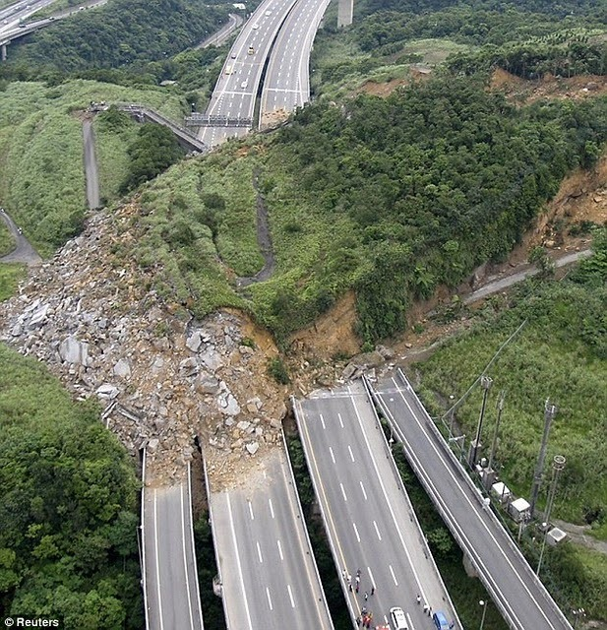
Notes:
Front view. Notice debris from wall on the left side (all the grey)

Slide 7
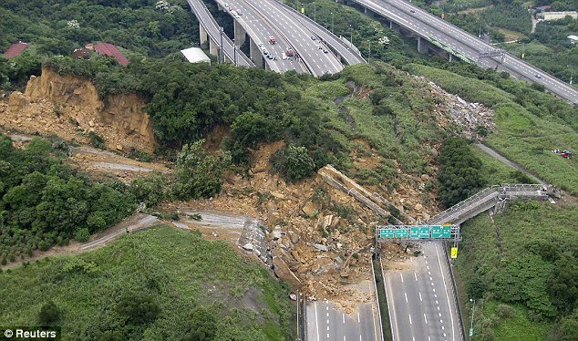
Notes:
Back view.
Notice triangular shape, failure plane obvious.
Overpass destroyed (part of it is behind the green signs)

Slide 8
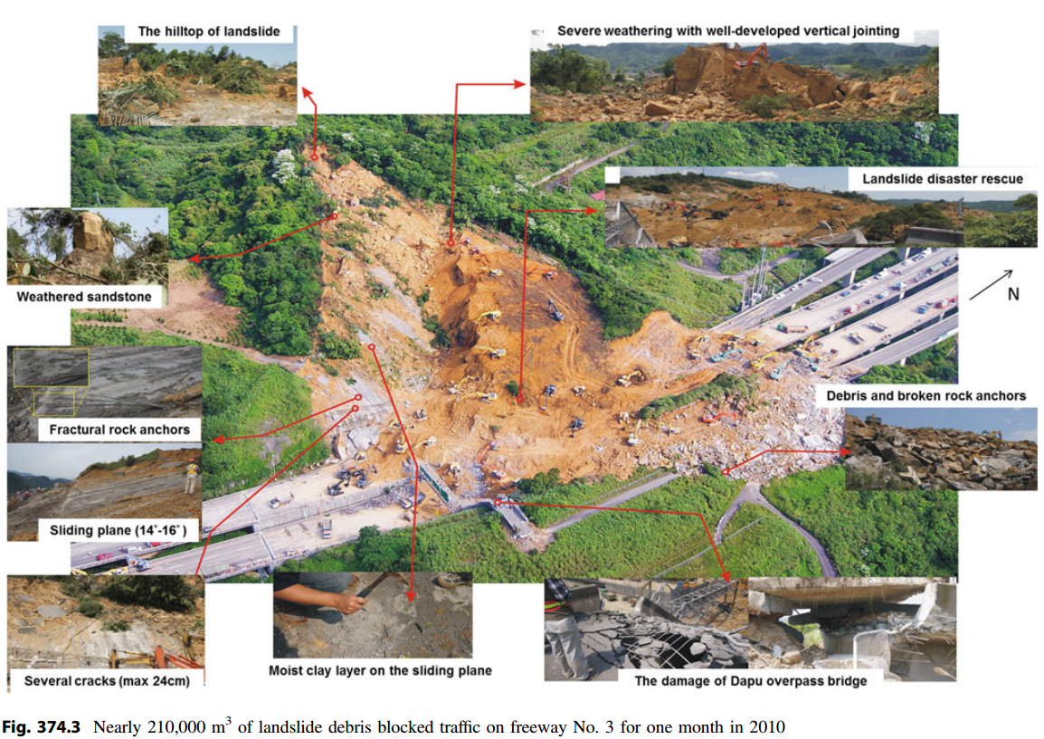
Notes:
Debris and broken rock anchors (right side)
Weathered sandstone & sliding plane (Left)
Fractural rock anchors & Cracks (Left)

Slide 9
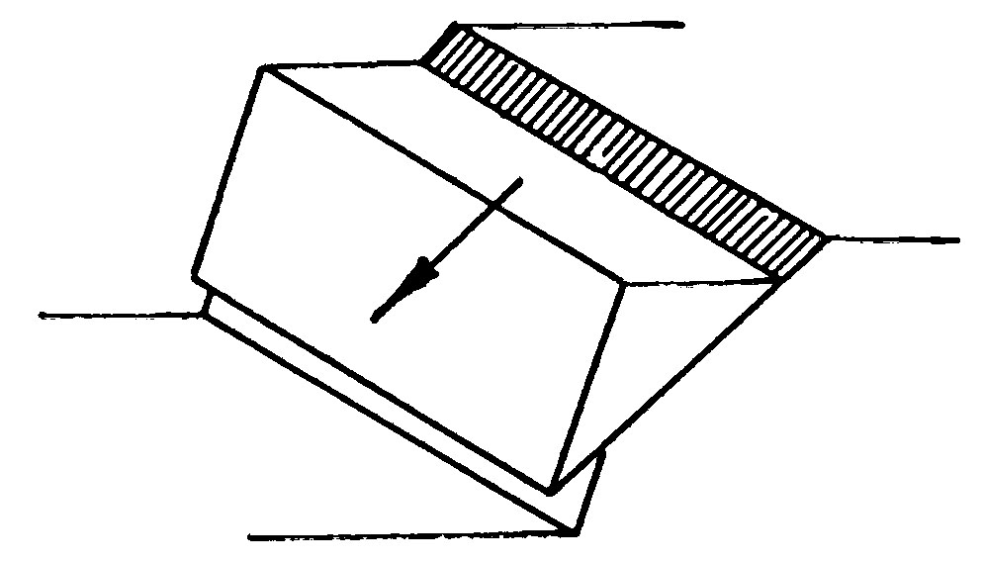
Notes:
Sliding block slope/they called it dip slope
Same as this, but the area was triangular

Slide 10
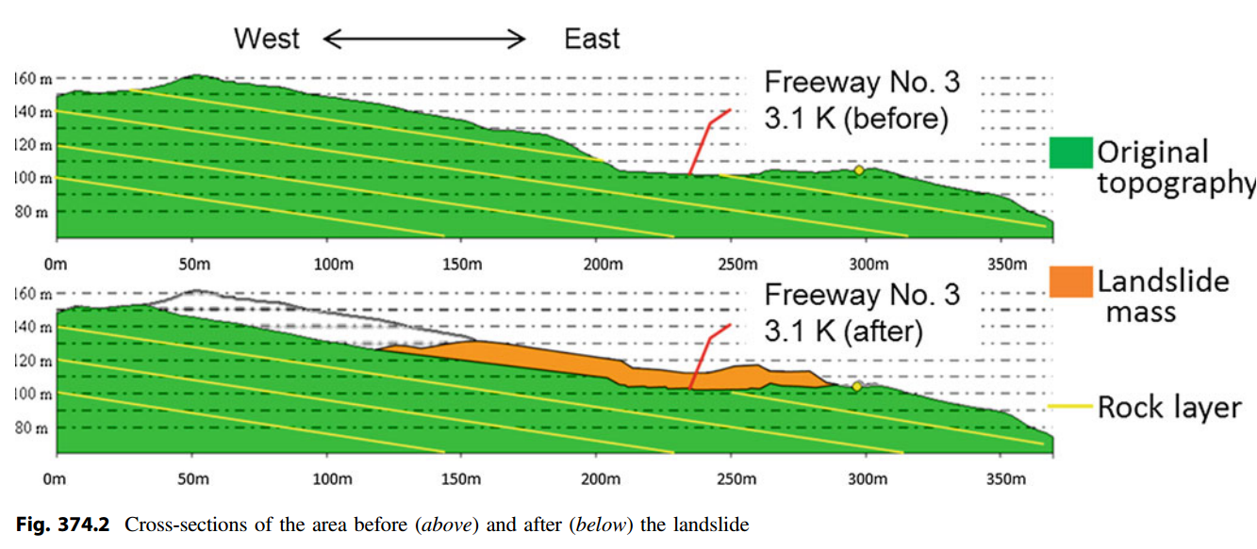
Notes:
Sliding plane is parallel with rock layer.

Slide 11
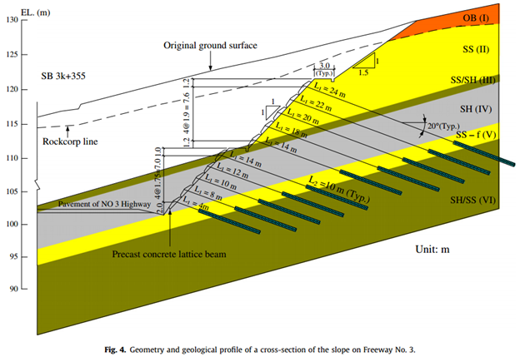
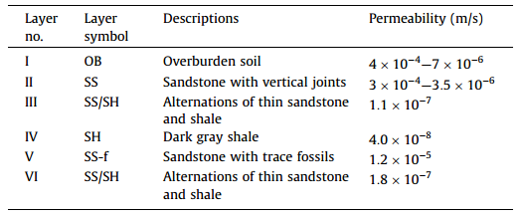
Notes:
Soil Layers
Anchor placement provided mechanism for weathering/infiltration into top layer above sliding plane.
Increasing the slope/unloading the toe contributed to failure

Slide 12
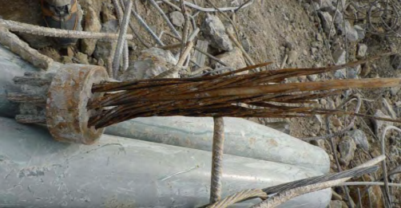
Notes:
Getting into causes now
Failed anchors. Many of them had corroded.
Field investigations→ only 58 anchors remained in place after the slope failure.
48% of the remaining anchors showed a fracture of steel strands.

Slide 13
Factor of Safety Considerations
Notes:
This was done afterward using original data but new methods, all values in these analyses, except for the earthquake where the slope was 1:1 are fine

Slide 14
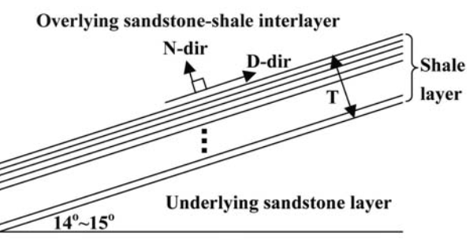
Analysis of Spatial Variability
Notes:
Spatial Variability in the Normal direction. D-direction is not expected to vary much
Looking at variability in the friction angle at different depths within the shale layer.
They performed an analysis similar to the probability of failure or reliability calculations we learned about in class on Tuesday.

Slide 15
Notes:
Two borings were taken in this area to investigate the shale layer that was the failure plane.
Average tan(Φ) values were calculated for each of the borings. Found to be 0.335
Coefficient of variance (COV) of tan(phi) was estimated using a database of residual strengths for similar rock layers in northern Taiwan
COV found to be 0.2, which is within the range found in other research for similar materials

Slide 16
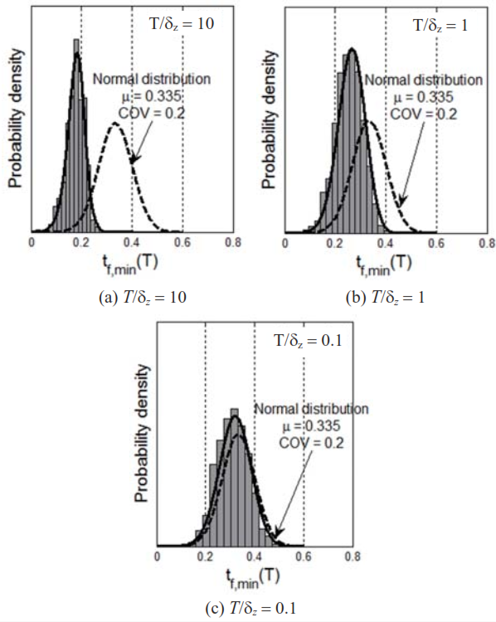
Notes:
Histogram developed with the COV and averages found previously and 1000 randomly generated samples using a Monte Carlo simulation similar to the one Dr. Jones explained in class on Tuesday.
T/gamma is the variability of the tangent of the residual friction angle. When the layer is not variable (T/gamma is small), the generated samples nearly perfectly lines up with the normal distribution, but as variability is taken into account the two distributions vary greatly.

Slide 17
Risk Levels
Notes:
Design scenario using the numbers used in the original design (slightly less conservative than the numbers found in tests performed on the material from the borings after the failure)
Failure scenario used data found after the failure.
Only 10% of the anchors were still in place after the failure, and many of these were severely damaged, meaning that the actual % Remaining anchor force may have been closer to 0 than to 50%. However, even with all of the anchors included, the slope was still classified as hazardous.
Not accounting for variability in the materials on site in the original design is the most likely cause of this slope failure.

